Slide 1
ASP.NET Core
ASP.NET Core is the new web framework from Microsoft.
It has been fast, flexible, modern, and work across different platforms.
ASP.NET Core is the framework that can be used for web development with .NET.
ASP.NET Core is an open source and cloud-optimized web framework for developing modern web applications that can be developed and run on Windows, Linux and the Mac.
ASP.NET Core apps can run on .NET Core or on the full .NET Framework.
It was architected to provide an optimized development framework for apps that are deployed to the cloud

Slide 2
ASP.NET Core
ASP.NET Core improvements
Build and run cross-platform ASP.NET apps on Windows, Mac and Linux.
Built on .NET Core, which supports true side-by-side app versioning.
New tooling that simplifies modern Web development.
Single aligned web stack for Web UI and Web APIs.
Cloud-ready environment-based configuration.
Built-in support for dependency injection.
Tag Helpers which makes Razor markup more natural with HTML.
Ability to host on IIS or self-host in your own process.

Slide 3
ASP.NET Core
It is the redesign of an ASP.NET.
It is an open source.
.NET Core is a platform neutral.
It can target to Windows, Linux & Mac OS.
A unified way of building Web UI and Web APIs.
It is very easy to integrate a variety of client-side frameworks, including AngularJS, KnockoutJS and Bootstrap.
No ASP.NET Web Forms :(
There is no separate Web API and MVC and its combined together.
MVC 6 renamed as MVC Core or ASP.NET Core
NET Core does not support WPF, Win Forms, etc.
NET Core supports either MVC or Web API Application.
NET Core has different class libraries whereas the base class libraries are same but based on OS; the compiled code is different.

Slide 4
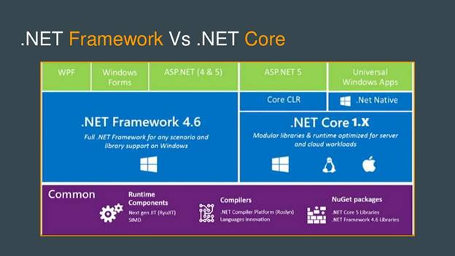
ASP.NET Core

Slide 5
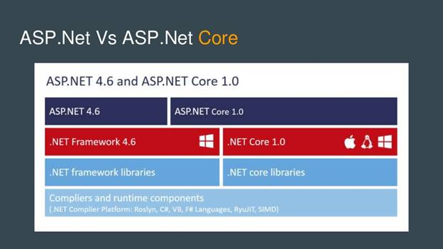
ASP.NET Core

